Slide 1
Machine Learning Meets Phylodynamics
A modern approach for historical host shifts

Slide 2
Intro
Evolutionary virologist
Rabies Phylogeography
Drivers of Equine Flu Evolution
EIV experimental transmission chain
Small-scale, detailed look at evolution of EIV
Notes:
So now I’m going from small-scale, local evolution of EIV to historical IAV host shifts.

Slide 3
Why Double the Analysis?
Both phylodynamics and protein chemical analyses are well-established
Combining a phylogeny-agnostic model with phylogenetic analysis
 | Protein Chemistry | Phylogenetics
Time-sensitive | ✗ | ✓
Experimentally-validated | ✗ | ✓
Relational | ✗ | ✓
Generalisable | ✓ | ✗
Accommodate highly-divergent samples | ✓ | ✗
Notes:
If they really are two sides of the same coin, or if one can present patterns in the data that the other is blind to.

Slide 4
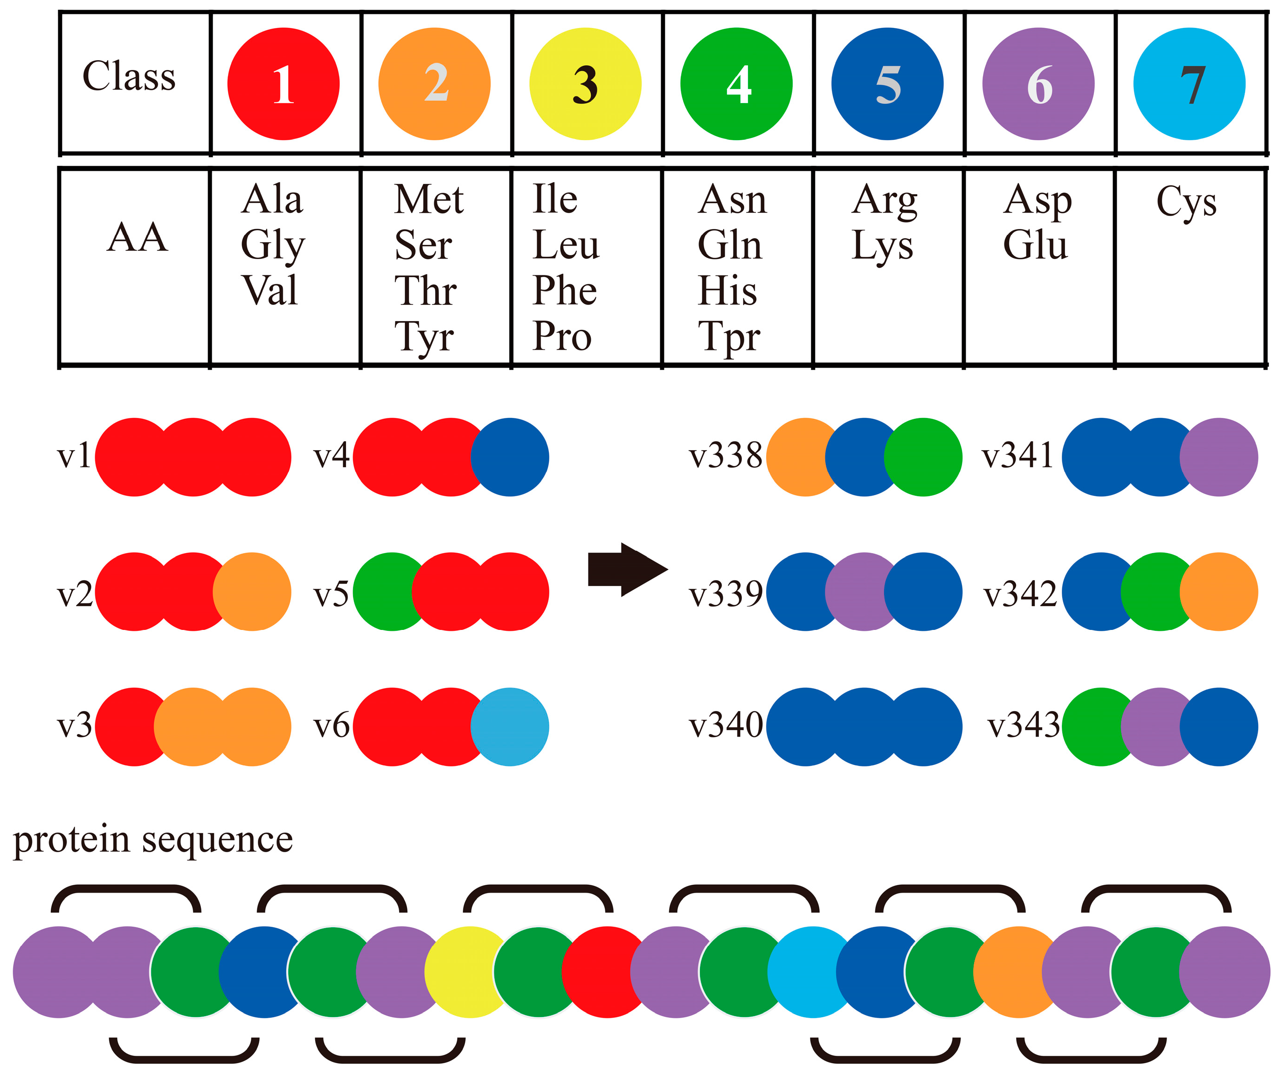
Machine Learning Models
Sequences are labelled according to the host of origin
Random Forest models are trained on protein properties
Compositional features
Physio-chemical features
1)
2)
3)

Slide 5
Random Forests
100 labelled sequences
RF₁
30 seqs
RF₂
30 seqs
RF₃
30 seqs
root
root
root
Avian
Mammal
Avian
Mammal
Avian
Mammal
Validate using the remaining 10 seqs
root
Aggregate
Avian
Mammal

Slide 6
Notes:
So which data did we use? We pulled all instances of flu genomes from NCBI when the host of origin was known and there were sequences for all 8 IAV genomic segments. Next, as the focus is on historical host shifts, we wanted only to keep samples that have naturally circulated in hosts from at least a year – no spillovers or recent jumps. This is just because the type of protein features tend to evolve slowly and take some time to adapt to a new host. Then, to train the models, we highlighted the IAV subtypes that appeared most frequently – subtypes which had more than 25 samples. The exception to this was two bat-specific subtypes, which had only 5 samples between them, but we needed some bat sequences to be included so the model had something to train on & recognise.

Slide 7
Feed H1N1 test data into Stack₁ model to assess model competency
Repeat for each of the 25 selected subtypes
Notes:
We therefore start with ~35,000 sequences, but many of these were similar enough to provide little novel information to the model so our first step was to cut down on the number of sequences we’d use. A clustering algorithm (within the MMSeq2 program) ran over these 35,000 samples and retained only those which had 95% or lower sequence identity in order to capture the widest range of diverse proteins. Then pulled features of these proteins using an array of compositional and structural

Slide 8
Machine Learning Models
Holding out each subtype allows us to create models and then validate those models by predicting on the held-out data
Segment_{[1-8]} • Feature_{[1-6]} • Subtype_{[1-25]} • Class_{[1-2]}
1200 two-class models (Avian/Mammalian)
1200 multi-class models (Avian/Bat/Dog/Horse/Human/Pig)
Compile the feature models together to combine their predictions
200 two-class stacks
200 multi-class stacks

Slide 9
Two-class Model
Multi-class Model
“Importance” (y-axis) is an internal metric within the model stacking process that describes how much of the variation can be explained by each composite model

Slide 10
Phylogenetics
How neatly do protein physio-chemical properties map onto trees?
8 trees, one for each genomic segment
BEAST tree estimation allows for ancestral inference of:
Discrete traits (e.g. host of origin)
Continuous traits (e.g. protein properties)
Do the patterns match predictions from the ML models?

Slide 11



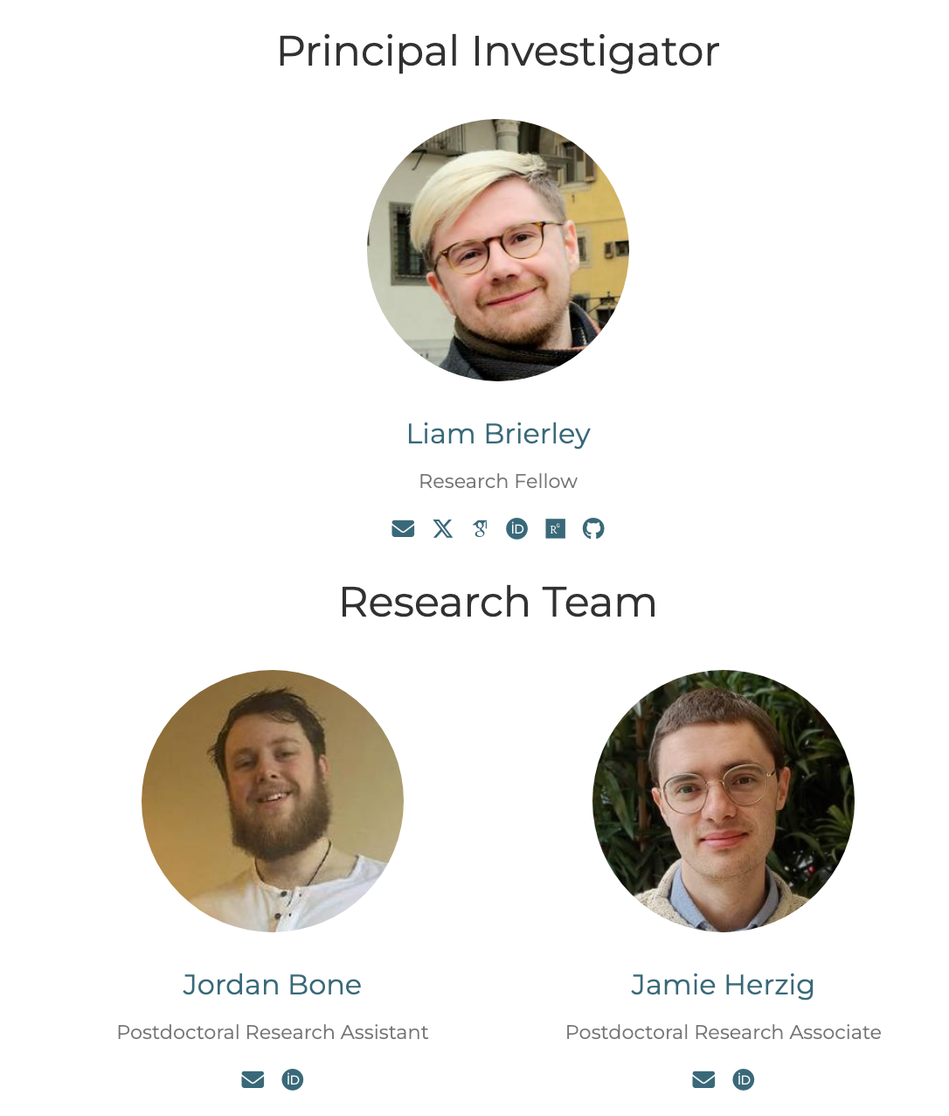



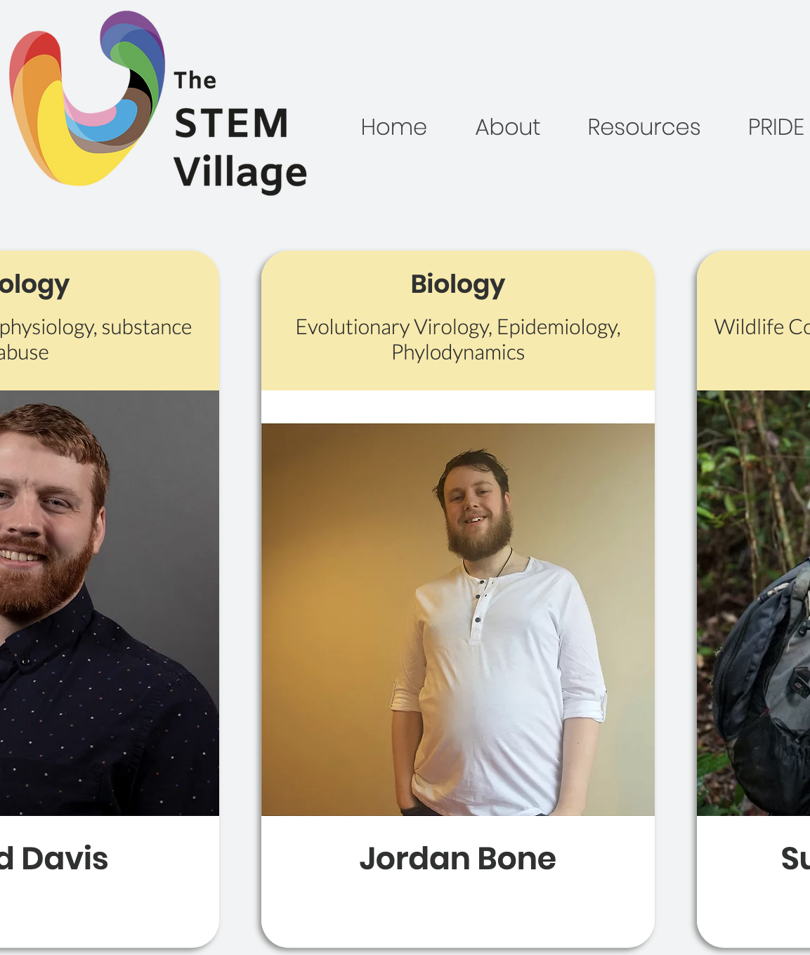

VIBE (Viral Informatics, Biostatistics, and Evolution) Research Lab
LinkedIn

